Slide 1
Capstone Project - The Battle of Neighborhoods
Finding the perfect home

Slide 2
Problem Definition
There are 31 neighborhoods in the city of Buffalo in NY state.
Our goal is to find a neighborhood that matches our preferences and comparable to where we live currently.

Slide 3
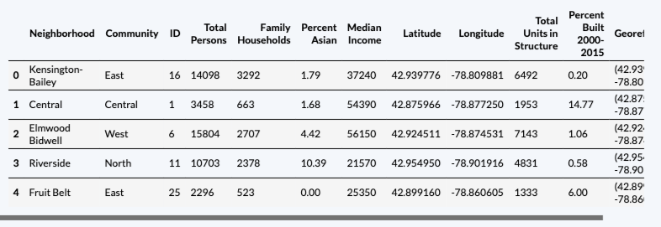
Data
Buffalo neighborhood data containing social, socio-economic, demographic and housing details for all the 31 neighborhoods
Sample data as below
Foursquare API. Top venues and their categories for each neighborhood

Slide 4
Methodology
k-means clustering algorithm to identify patterns in the data
top 5 venue categories for each neighborhood’s vector profile for clustering
clusters most meaningful and interesting with k=5

Slide 5
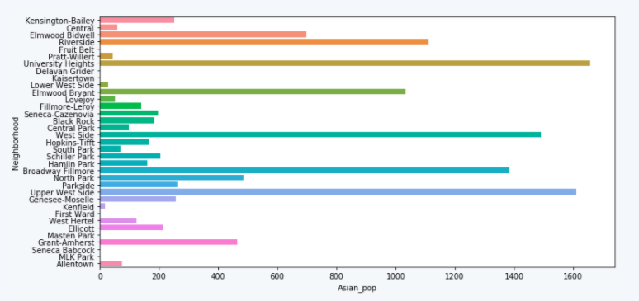
Asian Population distribution in various neighborhoods

Slide 6
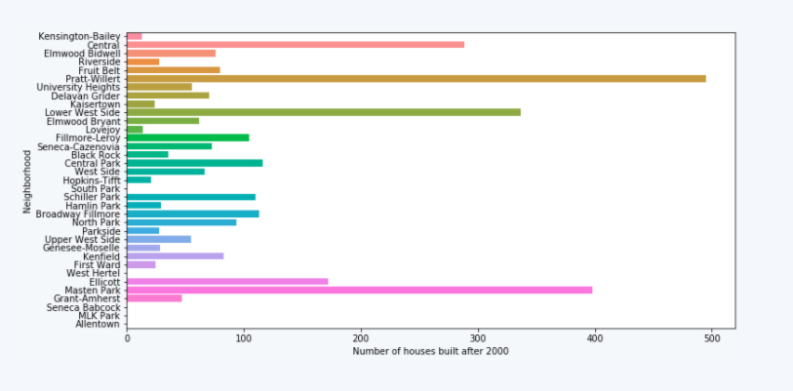
How the neighborhoods stack up with newer houses

Slide 7
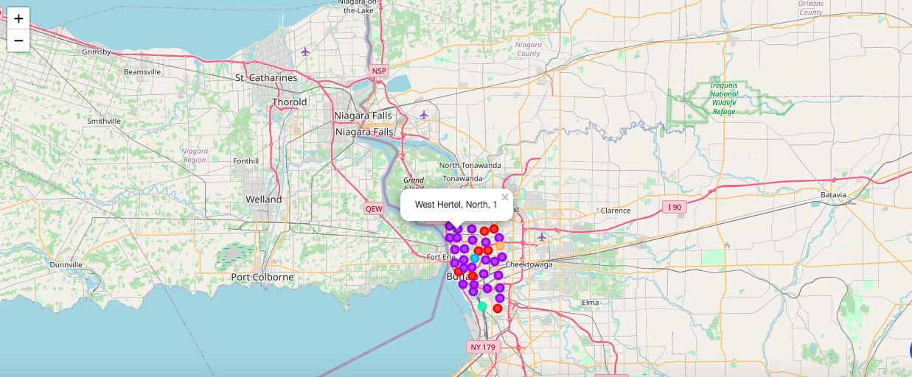
Neighborhood Cluster map

Slide 8
Results/Discussion
Coffee neighborhoods
Park Side
South Park
Restaurant neighborhoods.
West Side
Black Rock
Night Life neighborhoods
Central
Fillmore-Leroy
Hamlin Park
Elmwood Bidell
Central Park

Slide 9
Conclusion
31 Neighborhoods in City of Buffalo
31 cities with Foursquare API data representing 369 venues
Based on interests we can choose a neighborhood to buy a home

